Slide 1


COVID-19 DATA ANALYSIS
Higher Diploma in Science in Data Analytics
PRESENTED By NICHOLAS UDOMBOSO

Slide 2
Table of Contents
Introduction
Background
Literature review
specification and design
Testing and evaluation
conclusion

Slide 3
Introduction
Covid-19 virus is a pandemic(WHO,2020). It can be spread when people are in close proximity or when eyes, or nose are touched after touching contaminated surfaces without washing hands(WHO,2020).
The virus has negatively impacted:
Public health, economy, social life etc.
This project is about:
Providing reality check of the current spread of the pandemic via dashboard visualization.
Forecasting future trend of the disease in Ireland.
Implementing facemask detection model to support the control of the disease spread.

Slide 4
Background
It is public knowledge that the virus is still having its toll on people and remains a constant threat to public health, economy and social life.
Several efforts are continually ongoing to stop the virus.
Many countries have turned to data to analyse the numbers as it spreads in terms of cases, deaths and recoveries.
This project is about contributing to the efforts in bringing a stop to the spread of the disease.

Slide 5
Literature review
Several literatures have reviewed different approaches that have been used in different countries to model the prevalence of the disease. Below are few examples:
Anastassopoulou projected Covid19 to end or slowdown in February 2020 in China with SIRD (susceptible, infected, recovered, and dead) model (Katoch et al, 2021). However, most early predictions had challenges for lack of enough data(Liu et al, 2020).
Kumar et al. (2020) used Arima model to report that the spread would worsen in Iran and Europe (Katoch et al, 2021).
Using linear and exponential growth models, Strohman(2020) reported projection in the number of cases that would demand intensive care unit (ICU) admission in Italy estimating it to 14,542 by March 2020.
Ceylan (2020) formulated several timeseries models with ARIMA for Italy, Spain, and France with mean absolute percentage error (MAPE) values of 4.7520, 5.8486, and 5.6335 respectively.
Many countries till date have continued to build several models to predict the pandemic and continuously seek to improve performances of the models for better predictions.
Following this, my strategy in this project is to implement various models for Ireland and evaluate their performances. Then forecast covid19 in Ireland based on the best performed model.

Slide 6
Specification and Design
The following solutions have been designed and delivered in this project:
A: Dashboard visualization on the spread of the virus
B: Timeseries forecast of Covid19
C: Facemask detection model to support slowing the rate of transmission
System requirements/specifications:
System A: Tableau
System B: Timeseries Forecast models using Python
System C: Convolutional neural network (CNN) model

Slide 7
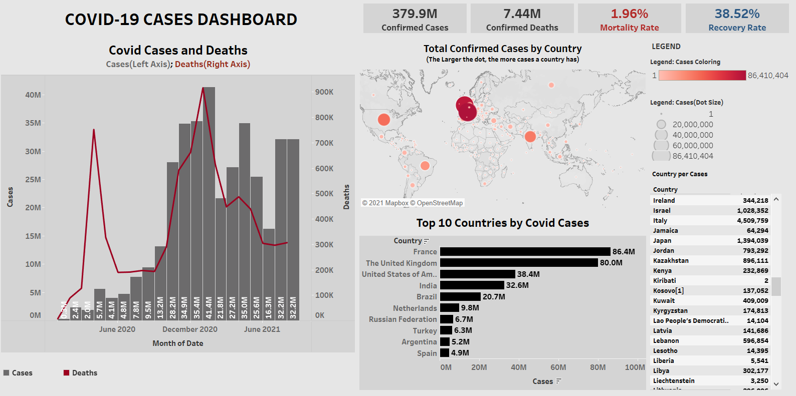
Specification and Design
A: Covid-19 Dashboard Visualization (Global):
To provide the current reality of the virus spread globally.
Tableau Dashboard:
Figure.1: Covid-19 cases dashboard.
379.9M cases have been confirmed globally with a mortality rate of 1.96% in August 2021.
France, UK and the United States are currently leading in cases.

Slide 8
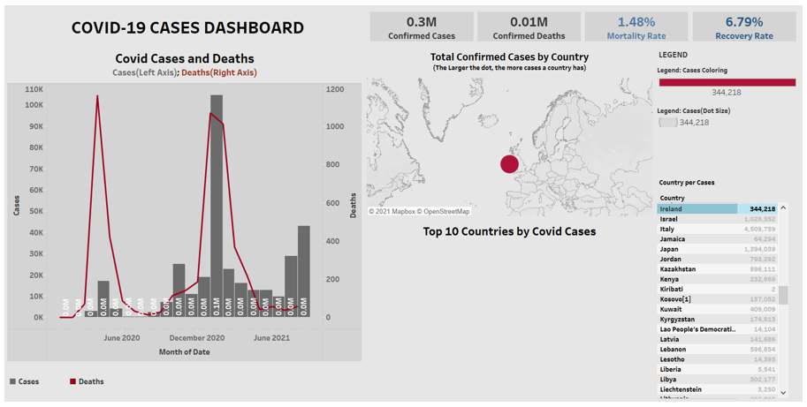
Specification and Design
A: Covid-19 Dashboard Visualization (Ireland):
To provide the current reality of the virus spread in Ireland.
Tableau Dashboard:
Figure.2: Covid-19 cases dashboard for Ireland.
In August Ireland had cumulatively registered 344,218 cases at 1.48% and 6.79% overall mortality and recovery rates from inception respectively.
In January 2021, Ireland recorded 104,768 cases – the highest till date.
Since February 2021 the cases have been decreasing but July and August are again showing the growing trend.

Slide 9
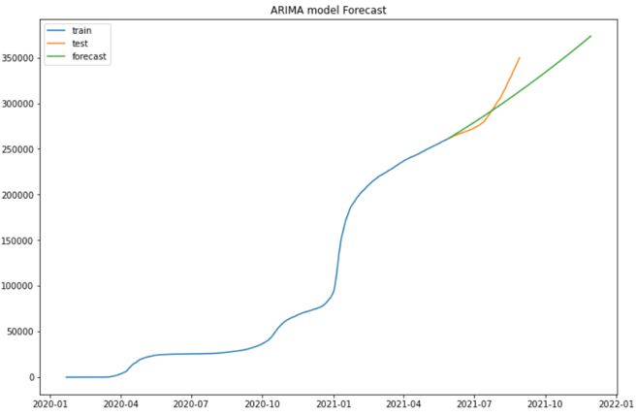
Specification and Design
B: Timeseries forecast of Covid19:
Three months forecast of the virus in Ireland was implemented (30-08-2021 to 29-11-2021).
Date range of the dataset:
(22-01-2020 to 29-08-2021).
Date range of the Train set:
(22-01-2020 to 28-05-2021).
Date range of the Test set:
(29-05-2021 to 29-08-2021).
Methods used:
i). Arima, ii). Facebook Prophet.
Arima model:
Figure.3: Arima Model Forecast
Arima model forecasts that covid19 virus cases will keep rising and approach approximately 380,000 confirmed cases in Ireland by November 2021.

Slide 10
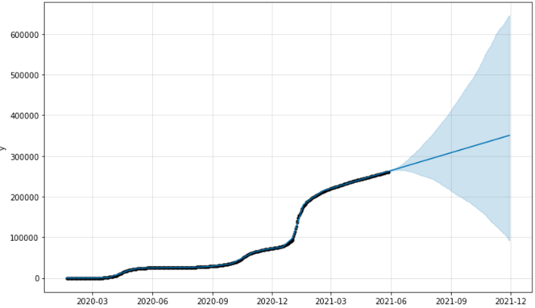
Specification and Design
B. Timeseries forecast of Covid19
(cont.):
Three months forecast of the virus in Ireland was implemented (30-08-2021 to 29-11-2021).
Date range of the dataset:
(22-01-2020 to 29-08-2021).
Date range of the Train set:
(22-01-2020 to 28-05-2021).
Date range of the Test set:
(29-05-2021 to 29-08-2021).
Methods used:
i). Arima, ii). Facebook Prophet.
Facebook Prophet model:
Figure.4: Prophet Model Forecast
In Ireland, Facebook prophet forecasts that the cases would rise above 350,000 by November 2021. It also forecasts the upper and lower ranges of the cases, that it could approximately fall to 93,000 or rise to 650,000 cases in November, 2021.

Slide 11
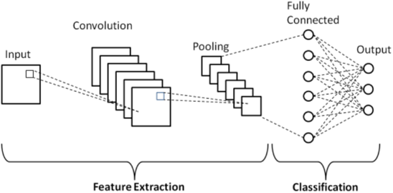
Specification and Design
C: Facemask Detection Model:
Convolutional Neural Network(CNN) model architecture:
Figure.5: CNN architecture
The model enables the network to receive input image, extract features and classify the image into categories.

Slide 12
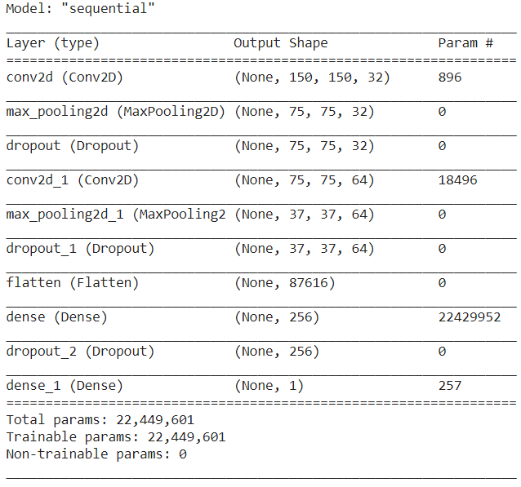
Specification and Design
C: Facemask Detection Model:
Implemented to detect if a person is wearing mask or not.
Convolutional Neural Network(CNN) model Implementation:
Figure.6: CNN model implementation
In this project I fed into the network 150 by 150 image input size with 32 filters.
The maxpooling layer down samples the image to 75 by 75, and again to 37 by 37.
Then in the flatten layer flattens the image up to one dimensional vector of 87616.
The image then passes through dense layer for classification and outputted as a single unit tensor shape.

Slide 13
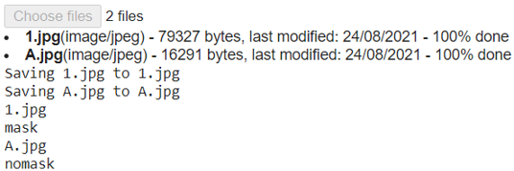
Specification and Design
C: Facemask Detection Model:
Implemented to detect if a person is wearing mask or not.
Convolutional Neural Network(CNN) model (Use):
Figure.7: Illustration of the CNN model use
New sets of images can be uploaded to the model via the ‘Choose files’ button.
The model classifies the uploaded image(s) into mask or nomask category.

Slide 14
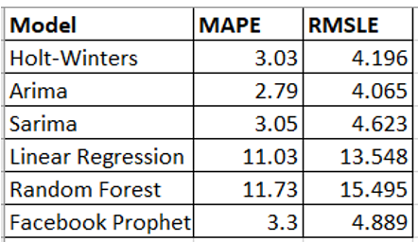
Testing and Evaluation
Timeseries Forecast models Performance:
The table below table summarises and compares the error metrics obtained from the models implemented in the project for Ireland.
Figure.8: Timeseries forecast models error metrics
Arima model shows best performed model on the data based on the achieved MAPE of 2.79 and RMSLE of 4.065. This is a very significant achievement.
Among the ML models(Linear regression, Random Forest, Prophet), Prophet model shows the best performed model on the data with MAPE of 3.3 and RMSLE of 4.889. A very good performance too.
Based on this, Arima and Prophet models were used to forecast Covid19 for Ireland from August 30 to November 39, 2021 as shown in the previous slides.

Slide 15
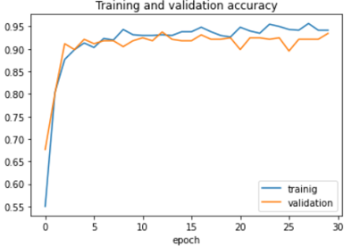
Testing and Evaluation
Convolutional Neural Model Performance:
Convolutional Neural Network(CNN) model:
Figure.9: CNN model performance
As shown in figure.9 94% training accuracy and 93% validation accuracy was achieved. Not much gap between them.

Slide 16
Conclusion & Future Work
The covid19 dashboard built on this project shows that the virus is still spreading and having a growing trend globally and in Ireland.
Forecast on Covid-19 shows from the results that the confirmed cases in Ireland would go as high as 650,000 cases or see a decline as low as 93,000 cases by end of November 2021.
In the future, more models can be implemented or one can improve the performance of the models used in this project to predict the pandemic. However, the Arima and Prophet models performed significantly well with MAPE values of 2.79 and 3.3 resp. for the forecast of the covid19 in Ireland.
Today timeseries forecasting is also applied in many applications like sales, weather, economic, healthcare, and business forecasts, etc. (Tableau).
Facemask detection model achieved 94% performance accuracy, a very significant performance. This is a measure to encourage mask wearing in public places to promote safety.
The facemask detection algorithm can be integrated to alarm systems in crowded places to notify when a person is wearing a mask or not to promote safety.

Slide 17
Thank You

Slide 18
References
Ceylan, Z. (2020). Estimation of COVID-19 prevalence in Italy, Spain, and France. Available at: https://www.sciencedirect.com/science/article/abs/pii/S0048969720323342 (Accessed: 15 August 2021).
Katoch, R and Sidhu, A. (2021). ‘An Application of ARIMA Model to Forecast the Dynamics of COVID-19 Epidemic in India’, Sage Journals. Available at: https://journals.sagepub.com/doi/full/10.1177/0972150920988653 (Accessed: 19 June 2021).
Tableau. Time Series Forecasting: Definition, Applications, and Examples. Available at: https://www.tableau.com/learn/articles/time-series-forecasting (Accessed: 5/09/2021).
Strohman, A. (2020). What Italy Can Teach Us About Reacting to the Coronavirus. Available at: https://www.americanactionforum.org/weekly-checkup/what-italy-can-teach-us-about-reacting-to-the-coronavirus/ (Accessed: 15 July 2021).
WHO(2020).’ Coronavirus disease (COVID-19): How is it transmitted?’ Available at: https://www.who.int/emergencies/diseases/novel-coronavirus-2019/question-and-answers-hub/q-a-detail/coronavirus-disease-covid-19-how-is-it-transmitted (Accessed 28 July 2021).

